Slide 1
Remote Sensing

Slide 2
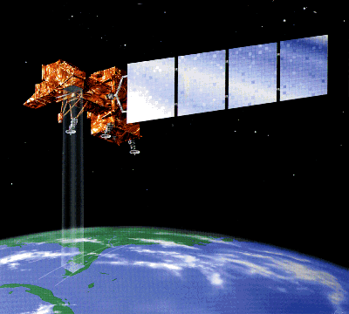
What is remote sensing?
Remote Sensing is the acquisition of information about an object without being in physical contact with it.
Remote Sensing is the science of acquiring, processing and interpreting images that record the interaction between electromagnetic energy and matter

Slide 3
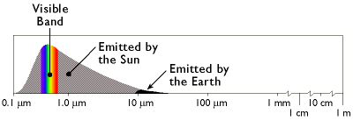
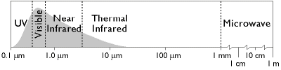
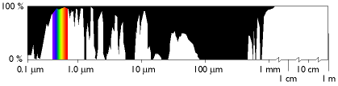
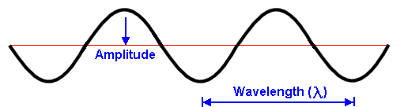
What is electromagnetic energy?
more
less
Magnitude
more
Magnitude
bands, or regions
less
Transmissivity
Wavelength
Transmissivity - a measure of the ability of a material or medium to transmit electromagnetic energy, as light. (dictionary.com)
Notes:
The transmissivity of the atmosphere across a range of wavelengths. Black areas indicate wavelengths at which the atmosphere is partially or wholly opaque. After Lillesand and Kiefer (1994).
At certain wavelengths, the atmosphere poses an obstacle to satellite remote sensing by absorbing electromagnetic energy. Sensing systems are therefore designed to measure wavelengths within the windows where the transmissivity of the atmosphere is greatest.

Slide 4
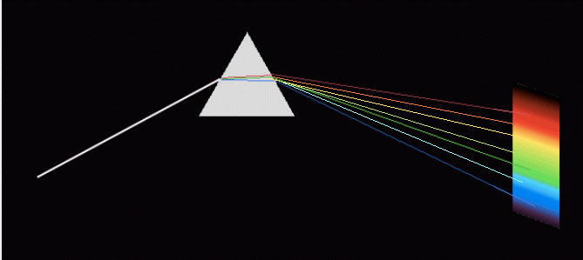
Light
In 1676, Isaac Newton demonstrated that white light is composed of a spectrum of many colors
Notes:
A light that appears white is a combination of wavelengths that can be decomposed by passing it through a prism or diffraction grating. In fact, Newton demonstrated that the colors could be recombined, showing that those components forms a light that is perceived as white again. The term “white light” is a description of the perception it induces in the mind, not of an intrinsic characteristic of the light.

Slide 5
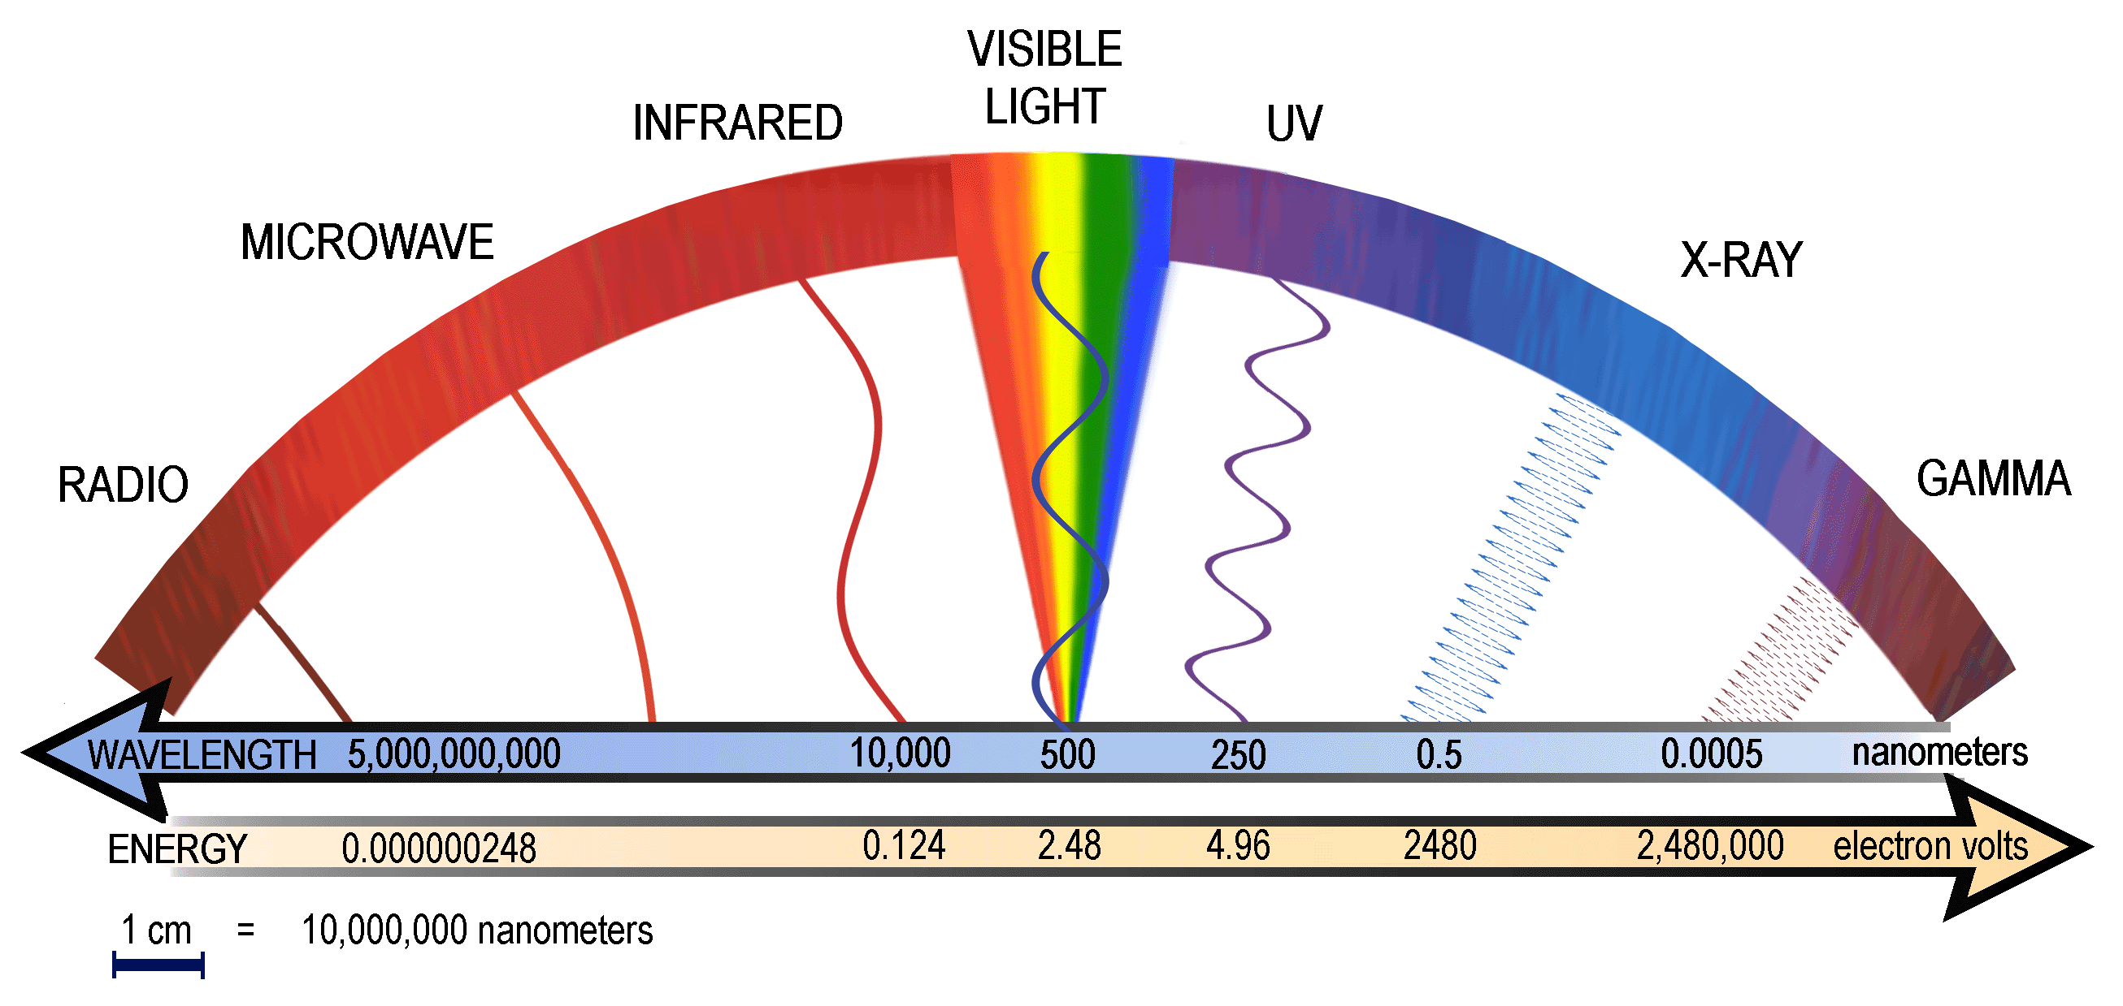

Slide 6
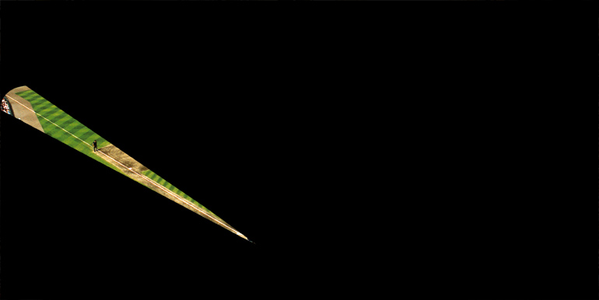

Slide 8
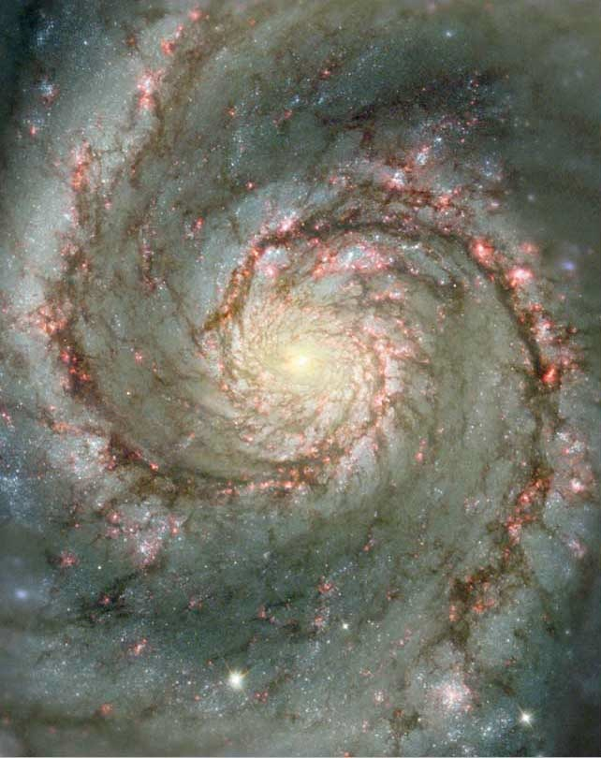
Notes:
Whirlpool galaxy

Slide 10
Notes:
For example, viewing in the IR reduces a lot of the cloud and dust cover.

Slide 11
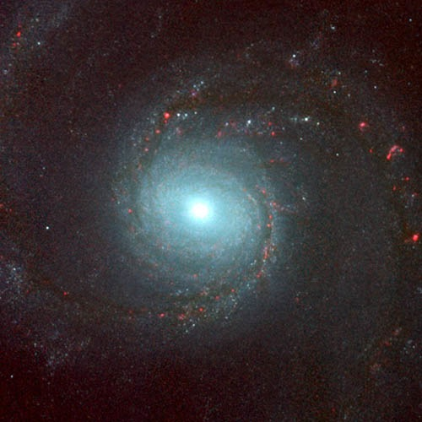

Slide 13
Notes:
The Thermal IR image shows here the most heat is.

Slide 14
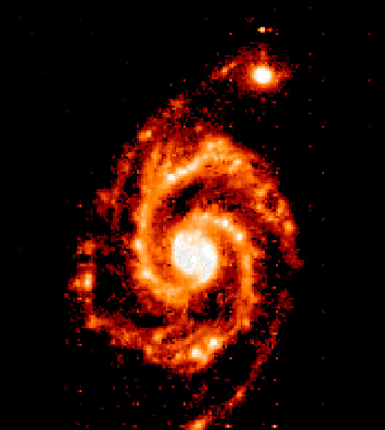

Slide 16
Notes:
The radio waves image allows you to see quasars, which were not visible in any of the previous images

Slide 17
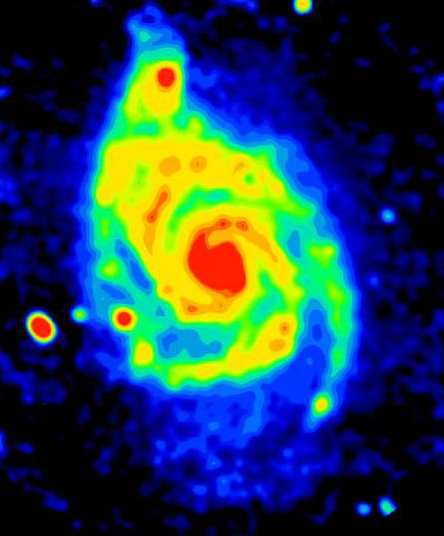

Slide 19
Notes:
And in the x-ray image black holes suddenly appear (and you'll notice that the star at the center is now invisible)

Slide 20
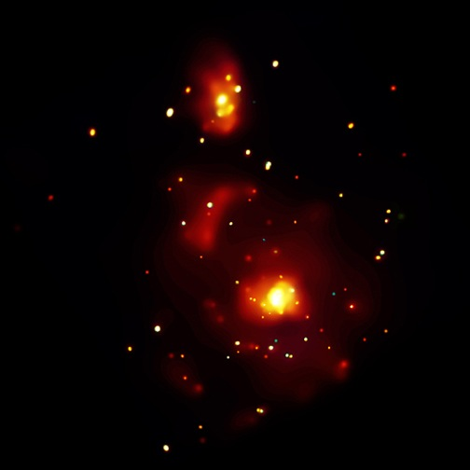
Notes:
And in the x-ray image black holes suddenly appear (and you'll notice that the star at the center is now invisible)

Slide 22
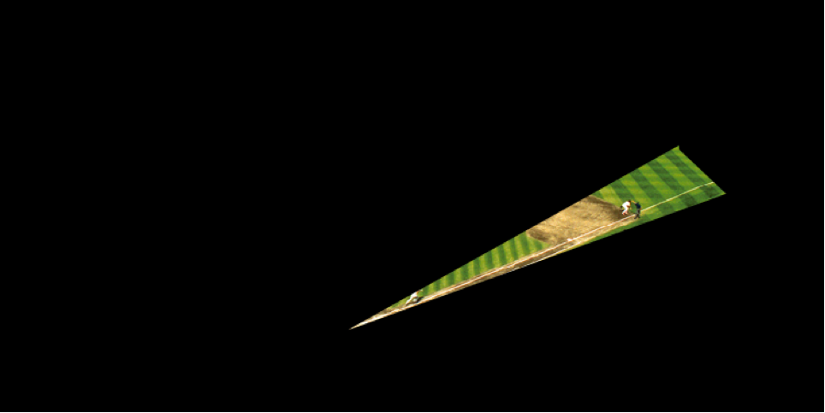

Slide 23
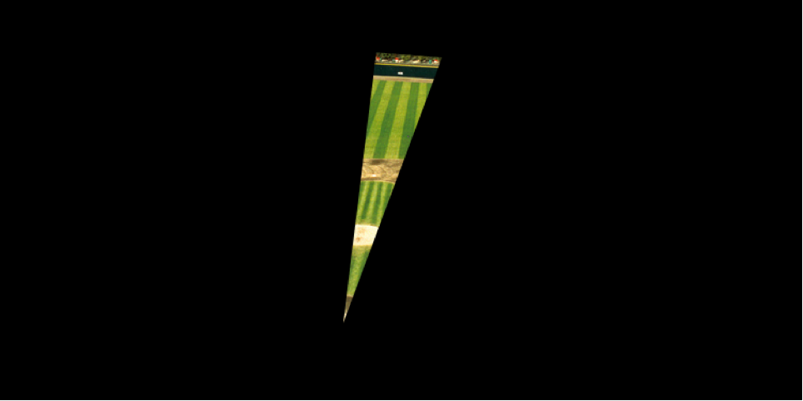

Slide 24
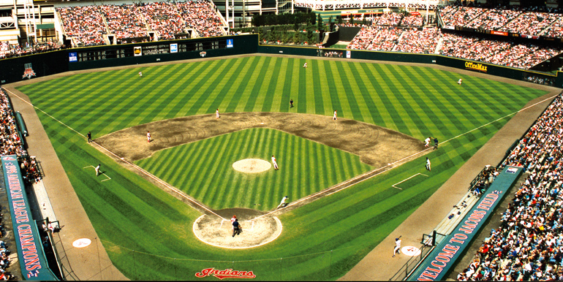

Slide 26
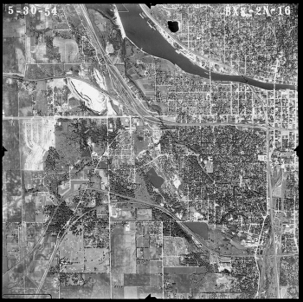
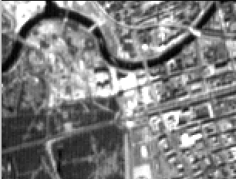
What are remotely sensed image data?
Digital data, Binary values, Raster
Notes:
Digital data, stored as Binary values, in Raster format

Slide 27
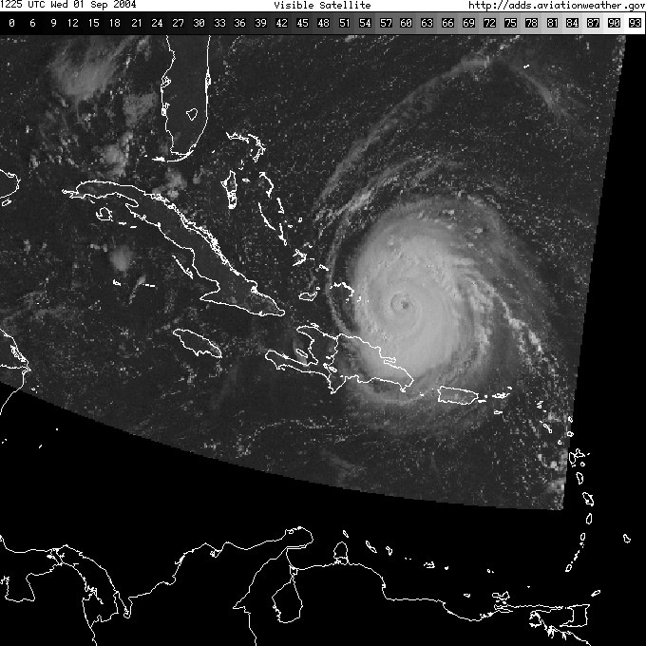
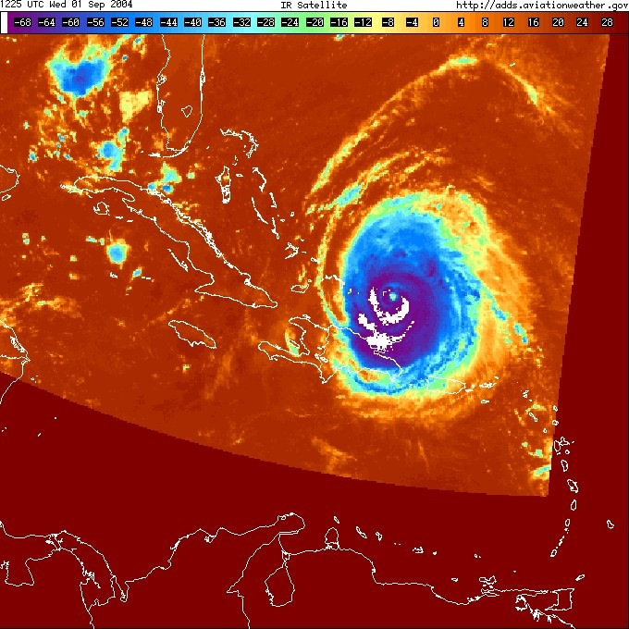
POES (Polar orbiting environmental satellite) visible channel: 12 UTC 9/1/04
POES thermal infrared channel: 12 UTC 9/1/04

Slide 28
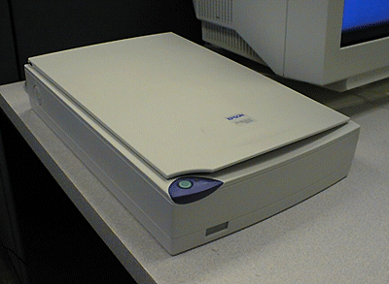
How do sensors record e.m. energy?
sensor = scanner = instrument
- energy source: reflected/emitted
- rows (raster)
- convert to electrical charge
- convert to digital data
Earth is big, curved, moving, has an atmosphere.
Distance, latitude, season (axis tilt), time of day (rotation) all have an effect.
Image Processing is required

Slide 29
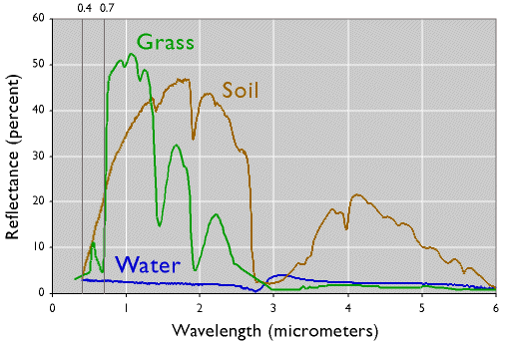
What are spectral response patterns?
(Signatures)
Notes:
The various objects that make up the surface absorb and reflect different amounts of energy at different wavelengths. The magnitude of energy that an object reflects or emits across a range of wavelengths is called its spectral response pattern.
Like most vegetation, the chlorophyll in grass absorbs visible energy (particularly in the blue and red wavelengths) for use during photosynthesis. About half of the incoming near-infrared radiation is reflected, however, which is characteristic of healthy, hydrated vegetation. Brownish gray soil reflects more energy at longer wavelengths than grass. Water absorbs most incoming radiation across the entire range of wavelengths. Knowing their typical spectral response characteristics, it is possible to identify forests, crops, soils, and geological formations in remotely sensed imagery, and to evaluate their condition.

Slide 30
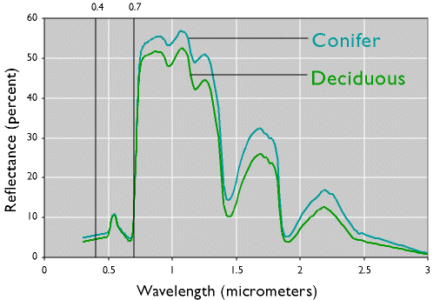
What are spectral response patterns?
(Signatures)

Slide 31
What’s important about all this?
Ability to visualize and analyze invisible as well as visible electromagnetic energy wavelengths
Ability to differentiate between visually (to our eyes) similar features
Ability to map larger areas of the Earth’s surface more frequently

Slide 32
What is resolution?
Spatial
Spectral
Radiometric
Temporal

Slide 33
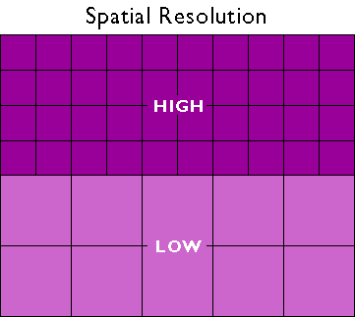
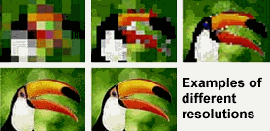
What is spatial resolution?
- Measure of the fineness of detail visible in a remote sensing image
- Determines size of the smallest area that can be resolved by the sensor.
- Higher resolution images = sharper more detailed.
- Commonly expressed as pixel size in meters.
Think Raster Data cell size
Notes:
resolution is the least detectable difference in a measurement.

Slide 34
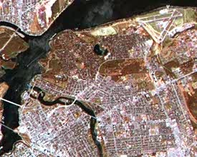
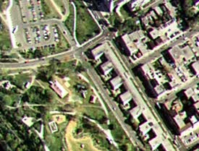
Spatial Resolution Example
Coarse Resolution
AVHRR-1.1km-MODERATE
GOES-25km-VERY COURSE
Fine Resolution
SPOT Panchromatic -10m
LANDSAT -30m

Slide 35
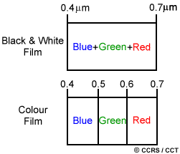
What is spectral resolution?
Spectral resolution or spectral sensitivity is :
Description of a sensors ability to discriminate fine spectral differences.
Smallest band or portion of the electromagnetic spectrum in which objects are discernable.
Specific wavelength intervals detected by a sensor
Notes:
Reference - http://www.ccrs.nrcan.gc.ca/resource/tutor/fundam/chapter2/04_e.php
Spectral resolution describes the ability of a sensor to define fine wavelength intervals. The finer the spectral resolution, the narrower the wavelength range for a particular channel or band.
Black and white film records wavelengths extending over much, or all of the visible portion of the electromagnetic spectrum. Its spectral resolution is fairly coarse, as the various wavelengths of the visible spectrum are not individually distinguished and the overall reflectance in the entire visible portion is recorded. Colour film is also sensitive to the reflected energy over the visible portion of the spectrum, but has higher spectral resolution, as it is individually sensitive to the reflected energy at the blue, green, and red wavelengths of the spectrum. Thus, it can represent features of various colours based on their reflectance in each of these distinct wavelength ranges.

Slide 36
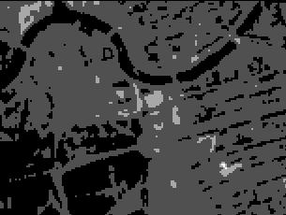
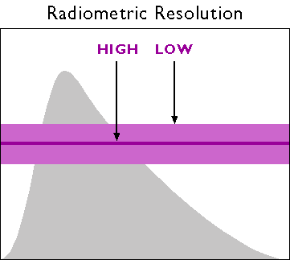
What is radiometric resolution?
How good is the instrument at measuring small differences in the magnitude, or brightness, of radiation within the ground area corresponding to a single raster cell.
Radiometric resolution determines how fine the sensor can distinguish between objects of similar reflection. The higher the radiometric resolution, the better we can distinguish between even subtle differences in reflection.
The number of possible data values in each band.
magnitude
wavelength
Notes:
Radiometric resolution
http://en.wikipedia.org/wiki/Image_resolution#Radiometric_resolution
Radiometric resolution determines how finely a system can represent or distinguish differences of intensity, and is usually expressed as a number of levels or a number of bits, for example 8 bits or 256 levels which is typical of computer image files. The higher the radiometric resolution, the better subtle differences of intensity or reflectivity can be represented, at least in theory. In practice, the effective radiometric resolution is typically limited by the noise level, rather than by the number of bits of representation.
Analog dynamic range ,really bright differences can you docs, dynamix rbage

Slide 37
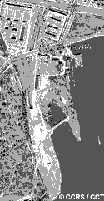
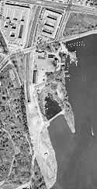
Another illustration of radiometric resolution
2-bit image
8-bit image
22 or 4 Shades of Gray
28 or 256 Shades of Gray

Slide 38
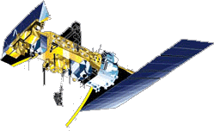
Temporal Resolution
How often the satellite system collects data of a particular area (repeat time)
Temporal Resolution
Every 16 Days
June 1, 2005
June 17, 2005
July 3, 2005

Slide 39
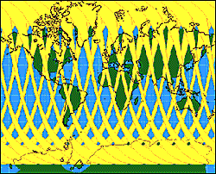
What is temporal resolution?
How frequently imagery is obtained for the same area.
Ability to collect imagery of the same area of the Earth's surface at different periods is critical
Spectral characteristics of features may change over time
Changes can be detected by collecting and comparing multi-temporal imagery.
The time factor in imaging is important when:
persistent clouds offer limited clear views of the Earth's surface (often in the tropics)
short-lived phenomena (floods, oil slicks, etc.) need to be imaged
multi-temporal comparisons are required (e.g. the spread of a forest disease from one year to the next)
the changing appearance of a feature over time can be used to distinguish it from near-similar features (wheat / maize)

Slide 40
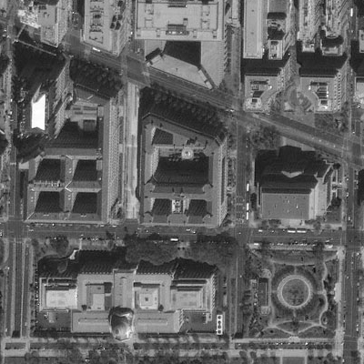
Let’s look at both Spatial and Spectral resolution
Next five slides describe 3 Multispectral scanning systems: IKONOS, AVHRR, and Landsat.
A multispectral system collects data over a variety of different wavelengths, or bands.
Take note of both the spatial resolution and the spectral resolution of each.

Slide 41
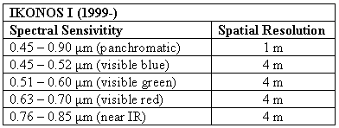
What is “high” spatial resolution?

Slide 42
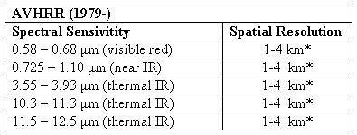
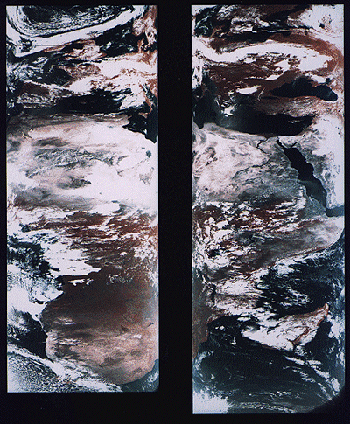
What is “low” spatial resolution?
Advanced Very High Resolution Radiometer
Notes:
AVHRR stands for "Advanced Very High Resolution Radiometer."
The data the sensors produce are widely used for large-area studies of vegetation, soil moisture, snow cover, fire susceptibility, and floods, among other things.
AVHRR sensors measure electromagnetic energy within five spectral bands, including visible red, near-infrared, and three thermal infrared. The visible red and near-infrared bands are particularly useful for large-area vegetation monitoring. The Normalized Difference Vegetation Index (NDVI), a widely used measure of photosynthetic activity that is calculated from reflectance values in these two bands, is discussed later.

Slide 43
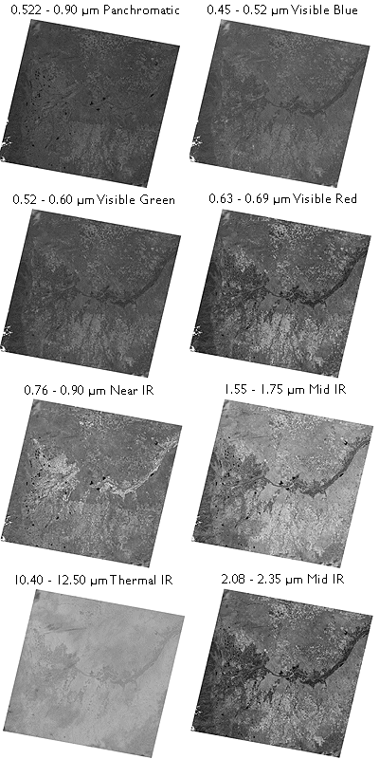
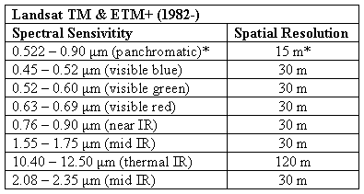
What is Landsat?
Notes:
Primarly environmental application, finer spatial resolution
Landsat satellites orbit the Earth at similar altitudes and velocities as the satellites that carry AVHRR, but because the MSS scan swath is so much narrower than AVHRR, it takes much longer (18 days for Landsat 1–3, 16 days for Landsats 4 and 5) to scan the entire Earth's surface.

Slide 44
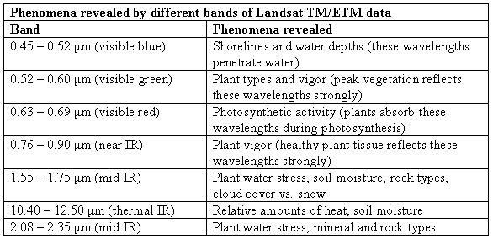
Why so many bands?

Slide 45
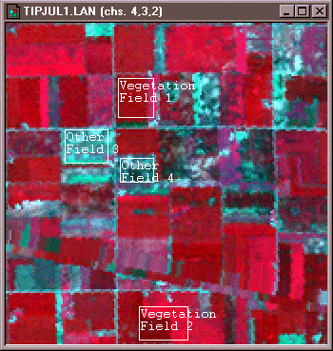
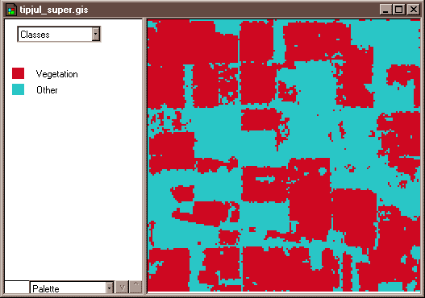
What is image data classification?
“Supervised” classification
The analyst specifies, in advance, the reflectance values typical of each landuse/cover type or class.
Notes:
Along with military surveillance and weather forecasting, the primary use of remotely sensed image data has been to monitor land cover and to inform land use planning. The term land cover refers to the kinds of vegetation that blanket the Earth’s surface, or the kinds of materials that form the surface where vegetation is absent. Land use, by contrast, refers to the functional roles that the land plays in human economic activities (Campbell, 1983).
For instance, to perform a supervised classification of the Landsat Thematic Mapper (TM) data shown above into two land cover categories, Vegetation and Other, you would first delineate several training fields that are representative of each land cover class. The illustration below shows two training fields for each class, however, to achieve the most reliable classification possible, you would define as many as 100 or more training fields per class.
The training fields you defined consist of clusters of pixels with similar reflectance or emittance values. If you did a good job in supervising the training stage of the classification, each cluster would represent the range of spectral characteristics exhibited by its corresponding land cover class. Once the clusters are defined, you would apply a classification algorithm to sort the remaining pixels in the scene into the class with the most similar spectral characteristics.
One of the most commonly used algorithms computes the statistical probability that each pixel belongs to each class. Pixels are then assigned to the class associated with the highest probability. Algorithms of this kind are known as maximum likelihood classifiers. The result is an image like the one shown below, in which every pixel has been assigned to one of two land cover classes.

Slide 46
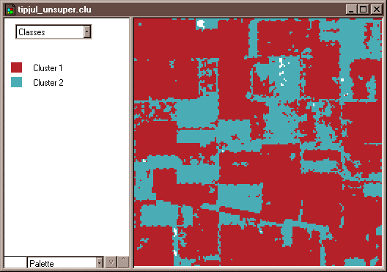
What is image data classification?
“Unsupervised” classification
Classes of reflectance values are first created by statistical software.
Then the analyst determines how the spectral classes correspond to landuse/cover categories.
Notes:
The image analyst plays a different role in unsupervised classification. As an image analyst, you would not define training fields for each land cover class in advance. Instead, you would rely on one of a family of statistical clustering algorithms to sort pixels into distinct spectral classes. You may or may not even specify the number of classes in advance. Your responsibility would be to determine the correspondences between the spectral classes that the algorithm defines and the functional land use and land cover categories established by agencies like the U.S. Geological Survey. The example that follows outlines how unsupervised classification contributes to the creation of a high-resolution national land cover dataset.

Slide 47
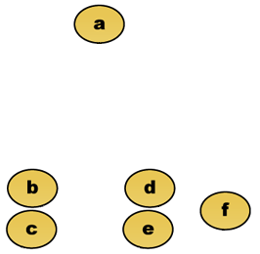
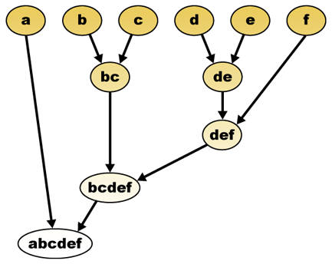
Clustering Basics
This example uses Euclidian distance
http://en.wikipedia.org/wiki/Data_clustering

Slide 48
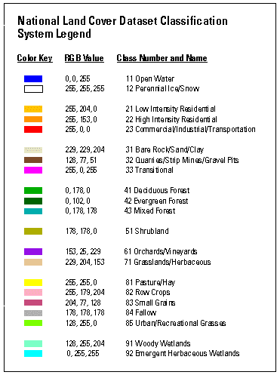
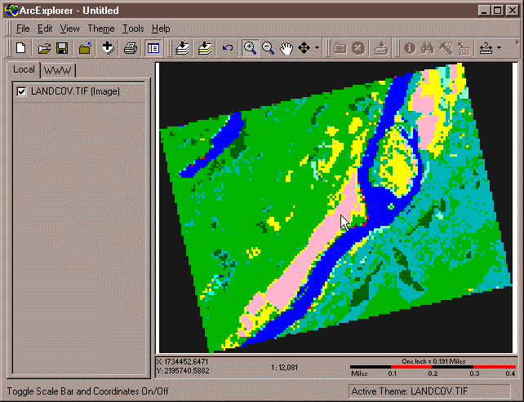
What is the National Land Cover Dataset?
http://nationalmap.gov/

Slide 49
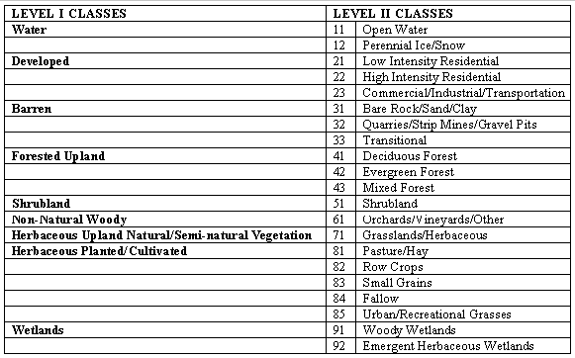
What is the National Land Cover Dataset?
Anderson Land Use / Land Cover Classification
Notes:
NLCD data are distributed by state, but they are produced as subsets of the 10 federal regions that make up the conterminous United States. The primary source data are bands 3, 4, 5, and 7 (visible red, near-infrared, mid-infrared, and thermal infrared) of cloud-free Landsat TM scenes acquired during the spring and fall (when trees are mostly bare of leaves) of 1992. Selected scenes are geometrically and radiometrically corrected, then combined into sub-regional mosaics comprised of no more than 18 scenes. All mosaics are then projected to the same Albers Conic Equal Area projection (with standard parallels at 29.5º and 45.5º North Latitude, and central meridian at 96º West Longitude) based upon the NAD83 horizontal datum.
An unsupervised classification algorithm is then applied to the preprocessed mosaics to generate 100 spectrally distinct pixel clusters. Using aerial photographs and other references, image analysts at USGS then assign each cluster to one of the classes in a modified version of the Anderson classification scheme. Considerable interpretation is required, since not all functional classes have unique spectral response patterns.

Slide 50
Types of Sensors
Passive sensors: measure ‘naturally occurring’ radiation
Active sensors: emit their own radiation and measure the reflection
Passive sensors have two main shortcomings
Cloud cover blocks these wavelengths
Only measurable in daylight hours
Active sensors use Longwave radiation (e.g., microwaves) that can penetrate clouds.
But objects on the surface of Earth do not emit enough microwaves to be easily detectable from space.

Slide 51
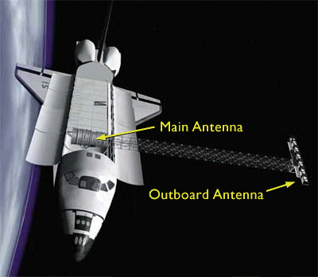



What is “active” remote sensing?
SRTM - Shuttle Radar Topography Mission

Slide 52





What is “active” remote sensing?
LiDAR - Light Detection And Ranging
http://www.csc.noaa.gov/products/sccoasts/html/tutlid.htm

Slide 53
Hands on
Downloading Landsat 8 Scene and a Supervised Classification using ArcGIS Pro
Notes:
srtm_adk
Imagery
H47
Digital orthoimagery - a remotely-sensed digital picture, stored in a raster data format. It is a georeferenced image prepared from a vertical photograph or other remotely-sensed data in which displacement of objects due to sensor orientation and terrain relief have been removed. Digital orthophotos combine the image characteristics of a photograph with the geometric qualities of a map.
CIR An example of multispectral data that includes part of the visible light spectrum as well as the near infrared. CIR is especially useful for vegetation mapping.
An overview of the Image Classification toolbar
Image classification using Spatial Analyst
True color 3R 2 G 1B

Slide 54
Getting the Data
USGS provides the data through two different viewers
Earth Explorer provides a direct link to the data including the raw data
Landsat Look is an ArcGIS Server Application which accesses the data and allows you to see it in a map display
Both have good and bad aspects to using them

Slide 55

Earth Explorer
earthexplorer.usgs.gov
Basic interface using goolge maps
You can either define your location manually, import a kml, shape file
Then you can set the date range

Slide 56

Earth Explorer
earthexplorer.usgs.gov
Basic interface using goolge maps
You can either define your location manually, import a kml, shape file
Then you can set the date range

Slide 57

Earth Explorer
Then you can select which dataset
Select Landsat -> Landsat Collection 1 -> Landsat Collection 1 Level 1 -> Landsat 8 OLI/TRIS C1 Level 1
In the Earth Explorer you have access to all of the previous Landsat Scenes as well as the latest images
For the most part there is 2-3 scenes per month for an area
Once you select the data you will then be given the ability to look at each dataset

Slide 58

Earth Explorer
Then you can select which dataset
In the Earth Explorer you have access to all of the previous Landsat Scenes as well as the latest images
For the most part there is 2-3 scenes per month for an area
Once you select the data you will then be given the ability to look at each dataset

Slide 59
Earth Explorer
As you work with the different datasets you will be able to see the footprint of the scene, the metadata, and then a few options for downloading
This is the found in the toolbar under each dataset
To download you can either download the scene processed, add to cart, or use the bulk data application to download

Slide 60


Earth Explorer Metadata

Slide 61

Download the Data
Click the download icon for your desired scene
Look for the Level-1 GeoTIFF Data Product and click download that
•The download will be around 700 megabytes
•Once you download it use 7zip and extract the file twice
Once for the .GZ and then for the .TAR files

Slide 62

ArcGIS
Now we have the GeoTIFFs and we can start to use the data
If you are working without the need to post process the images you can add in the images or a special file type which does do some of the processing for you
For processing the images ArcGIS has a few good tools

Slide 63


Catalog
Once you have unzipped all of the files you will be able to explore the data in Catalog View
You will see each band as a separate tiff image and a MLT.txt
The MLT.txt is the metadata as well as a raster product which can have different ways of viewing the data
This is helpful so you do not have to process the data

Slide 64

Supervised Classification
Right click on your Multispectral Band and add to New Map

Slide 65

Supervised Classification
Add Your Multispectral Raster Dataset to you map (Located in the MTL Raster Product Feature Class)
Explore Your Band Combinations using the Appearance Ribbon

Slide 66

Supervised Classification
Add Your Multispectral Raster Dataset to you map (Located in the MTL Raster Product Feature Class)
Explore Your Band Combinations using the Layer Properties and Symbology
Click on the Imagery Ribbon to see the different Image Processing Tools

Slide 67

Supervised Classification
Add Your Multispectral Raster Dataset to you map (Located in the MTL Raster Product Feature Class)
Explore Your Band Combinations using the Layer Properties and Symbology
Add your Image Classification Toolbar to your workspace
We are going to use the Classification Wizard to Classify our image

Slide 68



Supervised Classification

Slide 69


Supervised Classification

Slide 70


Supervised Classification

Slide 71


Supervised Classification

Slide 72


Supervised Classification

Slide 73
UAV - Regulations

Slide 74
Part 107
FAA Part 107 opened up the possibility of flying UAVs commercially in the US
Authorized September 2016
Before that companies had to submit for a 333 exception which was a long process
The goal of both is to make the US Airspace safe for all traffic
Hobbyists have been able to fly under the model airplane regulations which have been around for quite some time
They were not able to make money doing it
Students are exempt from 107 for classwork but teachers are required to have the certification
YouTube is a grey area but posting videos can generate money so it is best to have the license.

Slide 75
Basic Regulations Part 107
Unmanned Aerial Vehicle or System (UAV or UAS) is regulated from .55lbs to 55lbs
Anyone over 13 must register their unit if it meets those requirements
Maximum Altitude is 400 Average Ground Level (AGL)
Can fly 400ft around a structure for inspections
Maximum Speed is 100 miles per hour
No Flying within 5 miles of an airport without Air Traffic Control Approval (ATC)

Slide 76
Basic Regulations
No Flying Over People
No Flying after consuming Alcohol within 8 hours or with a .04BAC
Must keep visual line of sight to the aircraft (VLOS)
Cannot pose a safety risk to other aircraft or people

Slide 77
Where is it OK to Fly
Class G Airspace or with ATC Authorization

Slide 78
Airspace
Airspace | Think | Airport Traffic Control Permission
Class A | High Up | Prohibited
Class B | Biggest Airports | Yes (Check for altitude notation)
Class C | Large Airports | Yes (Check for altitude notation)
Class D | Medium Airport | Yes (Always starts at the surface)
Class E with an airport | Small Airport | Yes (Check for altitude symbol)
Class E without an airport | Almost everywhere but at the surface | No
Class G | Good to Go! | No (ATC doesn’t exist!)
https://3dr.com/faa/study-guides/airspace/

Slide 79
Sectional Charts

Slide 80

https://www.faa.gov/air_traffic/flight_info/aeronav/digital_products/vfr/

Slide 81


Slide 82


Slide 83
Aviation Weather
METAR
KROC 061554Z 32013G20KT 10SM FEW025 OVC032 09/03 A3002 RMK AO2 SLP171 T0089003
TAF
TAF AMD KROC 061519Z 0615/0712 32016G21KT P6SM BKN020 FM062000 30015KT P6SM BKN035 FM070200 31010KT P6SM FEW130 FM070900 33006KT P6SM SCT100

Slide 84
Aviation Weather
Outside of knowing your unit’s performance there are regulations when you can fly
Minimum Visibility 3 SM
Minimum 500 ft below the clouds and 2000 ft horizontally from clouds

Slide 85
Notice to Airmen and TFR
A Notice to Airmen (NOTAM) is a notice filed with an aviation authority to alert aircraft pilots of potential hazards along a flight route or at a location that could affect the safety of the flight. - notams.aim.faa.gov
Temporary flight restrictions - A TFR is a geographically-limited, short-term, airspace restriction, typically in the United States.

Slide 86


Slide 87


Slide 88
UAV Image Capture and Processing

Slide 89
UAV Types
There are two main types of UAVs
Fixed Wings
Multi-Roters
They have each have their own purposes

Slide 90
Examples of Fixed Wing UAVs

Slide 91
Uses of Fixed Wing UAVs
Large Scale Mapping Projects
Precision Agriculture
Elevation Models
Large flying area with low battery usage.
They need larger areas for landing and taking off
Not good for developing 3D models of a building

Slide 92





EXAMPLES OF MULTI-ROTORS

Slide 93
Multi-Rotor
Multi-rotor is what most people now think UAVs are
These are fairly easy to fly with vertical take off and landing
They can do a lot of different task such as mapping large areas, but also are great for inspections
They are limited in flight time because of the power needed to maintain flight

Slide 94
Capture Software
For the most part you do not even need to know how to fly, as many UAV’s are setup with autopilots
Using a software like Drone Deploy, Pix4D, Drone2Map, you pick what type of mission you want to do
Then draw your box and it does the rest

Slide 95
Sensor Packages
The UAV is only a mechanism for flying a sensor
Like we talked about in the Remote Sensing lectures, there are both passive and active sensors
You can put on LiDAR, Multi Spectral, and Thermal Images

Slide 96
Passive Sensors

Slide 97
Active Sensors

Slide 98

RIT’s UAV Has Both Types Sensors Onboard

Slide 99

Recommended Videos To Watch
Fixed Wing UAV Flight Procedures - https://youtu.be/RVPkibtxwKw
3D Model of a Castle with multiple types of UAVs - https://youtu.be/j7PGgrMSi5o
One of My Favorites Frozen in Time - https://youtu.be/Zhk5ZDzjiQg
This video uses UAVs, Other Types of Remote Sensing, and Fabel the Archeology Dog

Slide 100
What to Look for in a Trainer Drone
The Trainer Drones that I like are Parrot Mini Drones because they fly very similarly to my Parrot Anafi and the DJI Phantoms
They have been discontinued so they are hard to come by now
DJI has a Tello drone which is very similar to the mini drones and has a camera
There are a lot of other options out there. When looking for one that will fly just like many of the professional ones look for altitude hold using either optical or ultrasonic sensors
Some you will find require you to trim the power to maintain altitude, these while good for learning on handle different that the others but may also be even cheaper
I recommend also getting blade guards to protect the drone and things in your home and extra propellers because you will go through them while learning

Slide 101
Activity
Process a set of UAV images using ArcGIS Pro
Download the data http://downloads.esri.com/learnarcgis/estimate-storage-capacity-with-drone-imagery/yvwd-images.zip
Open a new Map project

Slide 102


Ortho Mapping Project

Slide 103


Orthomapping Project Wizard

Slide 104


Orthomapping

Slide 105

Orthomapping

Slide 106




Orthomapping

Slide 107


Orthomapping

Slide 108

Orthomapping

Slide 109
UAV Readings
https://www.faa.gov/uas/getting_started/part_107/
https://www.faa.gov/uas/getting_started/part_107/remote_pilot_cert/
(Optional but recommended if you want your certification https://www.asa2fly.com/Test-Prep-2020-Remote-Pilot-P4124C738.aspx)

Slide 110
Assignment
On the Sectional Chart that we created in class look up your own address or area.
Explain if you are authorized to fly in your area and what is the airspace. Include an exported map of your area in your write up.
Write up an explanation of a possible project that you could use an UAS Include the area that you would be flying, what possible authorizations you would need, and what type of UAS would you choose and why.
The sectional charts are in either ArcGIS Online or ArcGIS Pro. Search for Sectional or FAA
Or you can go to the FAA's website on the sectional charts https://www.faa.gov/air_traffic/flight_info/aeronav/productcatalog/vfrcharts/sectional/

